Slide 1


















Group 12
DATA
Tran Minh Hoang - Lecturer for English B2 Module

Slide 2











Group's Members
Q&A
Leader/Slide
Content
Nguyễn Quang Anh
Age: 20
Place of origin: Vĩnh Phúc
Hobby: Badminton
Nguyễn Khánh Duy
Age: 19
Place of origin: Hải Phòng
Hobby: Billiards/Make money
Đinh Lâm Phương
Age: 19
Place of origin: Hà Nội
Hobby: Online business

Slide 3




Contents
01
Introduction
02
Core content breakdown
03
Activities & Discussion
04
Summary & Conclusions
05
Q&A and References

Slide 4









a.Vocabulary
Analyse data : phân tích dữ liệu
Analyse activity : phân tích hoạt động
Offer perks : cung cấp đặc quyền
1.Introduction
Make recommentdations : kiến nghị
Abuse trust : lạm dụng lòng tin
Related to the unit: “Data”
Keep records : giữ hồ sơ
Target users : người dùng mục tiêu
Demographic : nhân khẩu học
Sophisticated : rắc rối
Encrypt : mã hóa

Slide 5






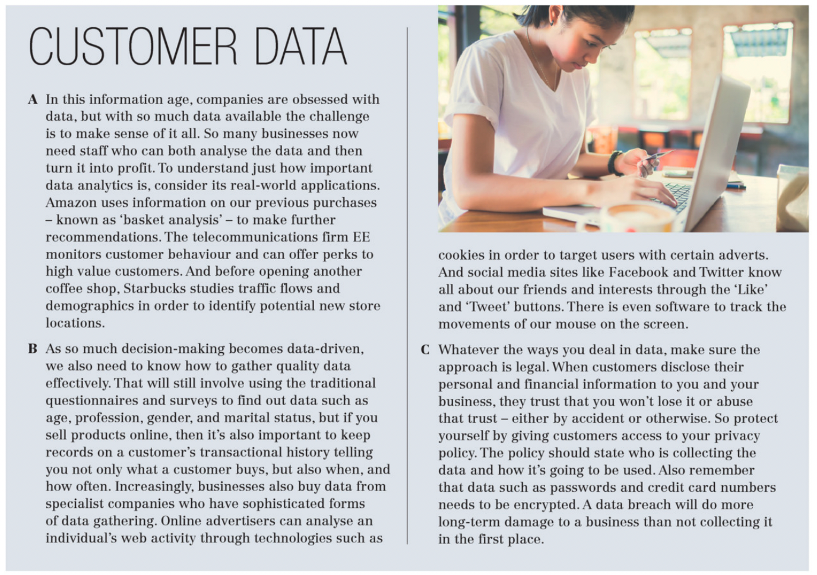











b.New phrases
Data analystics : phân tích dữ liệu
Data-driven: dựa trên dữ liệu
Financial information: dữ liệu tài chính
Long-term: lâu dài
Transactional : giao dịch

Slide 6
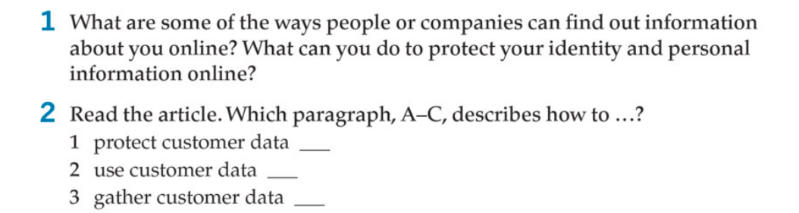
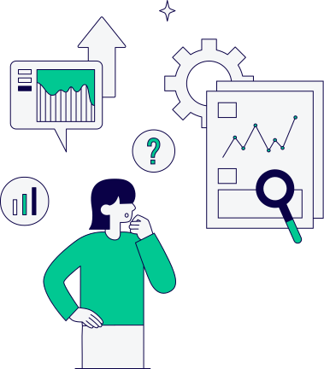
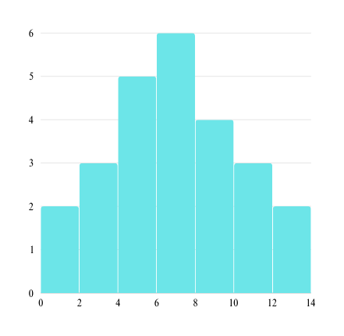
C
B
A

Slide 7





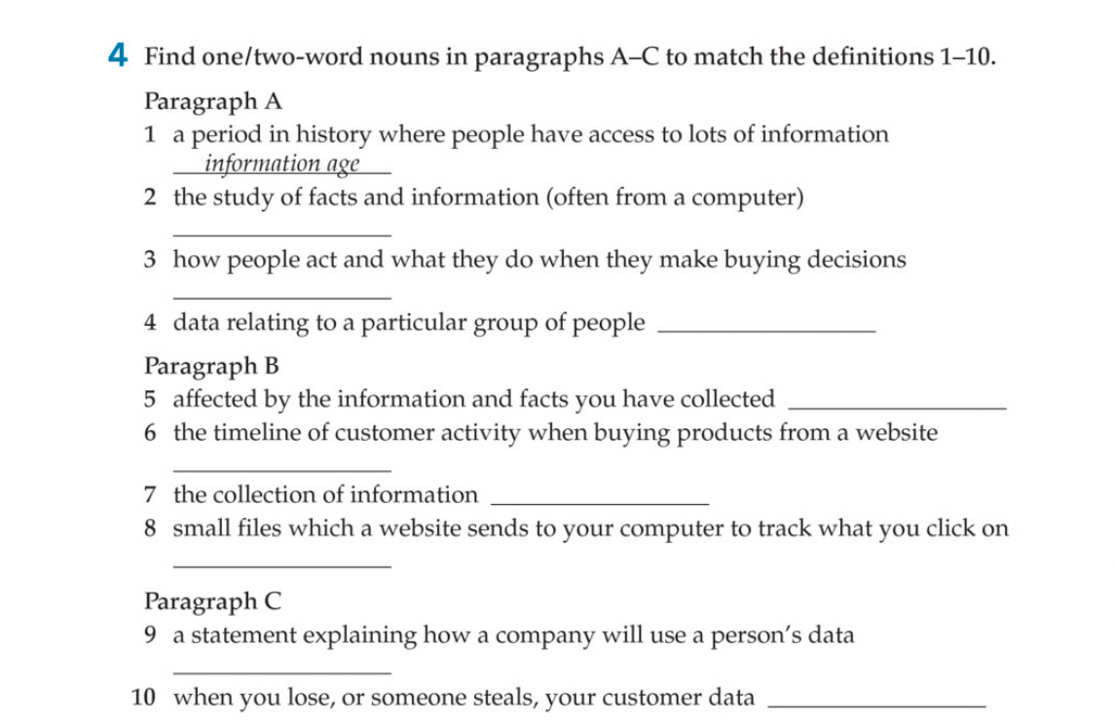








Core content breakdown
data analytics
customer behaviour
demographics
data-driven
transactional history
data gathering
cookies
privacy policy
data breach

Slide 8
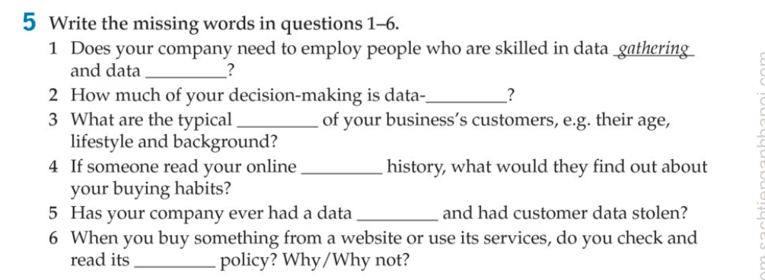
Core content breakdown
analytics
driven
demographics
transactional
breach
privacy

Slide 9






Business Communication
Business Communication
Relevance: Ads that are relevant to the user's interests and needs are more likely to be noticed and clicked on.
Placement: Ads that are placed in a prominent location on a website are more likely to be seen. However, care must be taken not to place ads in a way that interferes with the user's experience.
Design: Ads that are visually appealing and well-designed are more likely to grab attention.
Call to action: Ads that include a clear call to action, such as "Click here to learn more," are more likely to prompt a response from the user.
Targeting: Advertisers can target their ads to specific demographics, interests, and behaviors. This can help to ensure that the ads are seen by people who are most likely to be interested in what they have to offer.

Slide 10


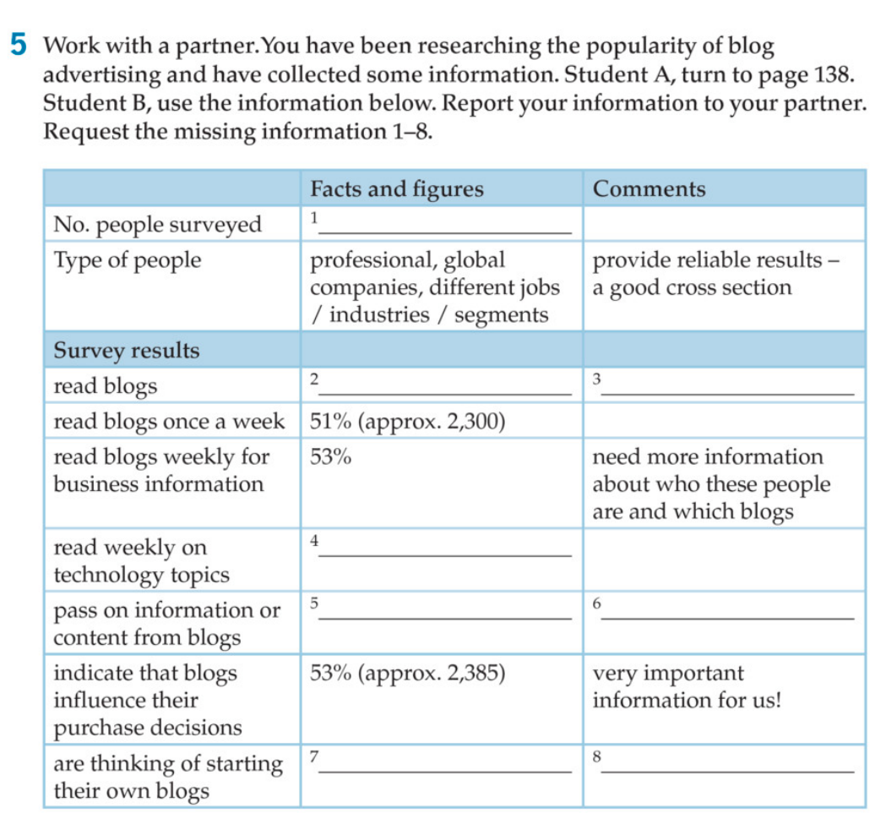

Just over 4,500
80%
ads will reach a lot of people
57%
70% (approx. 3,150)
word of mouth advertising will be useful
32%
growing market!

Slide 11





Practically speaking
Targeted reach
Relationship building
Should your business use email advertising campaigns? How effective are they?
Cost effective
Automation
Measurable results?
?Versatility

Slide 12


Cons
Unsubscribes and Spam complaints
Competition
Design Challenges
Legal considerations
Analytics Overload
Deliverability issues

Slide 13

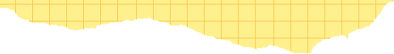




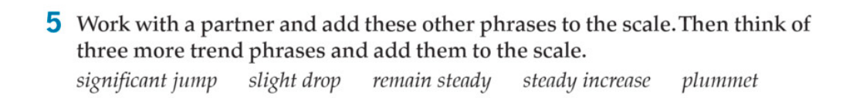





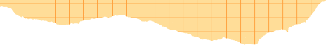
Answers:
fast/big fall: plummet, (significant drop)
slow/small fall: slight drop, (minor dip)
no change: remain steady, stay the same)
Slow/small rise: steady increase, slight upturn)
fast/bia rise: sianificant jump. (substantial hike)

Slide 14











Language at Work
How do you usually listen to music? For example, streamed online or on CD?

Slide 15
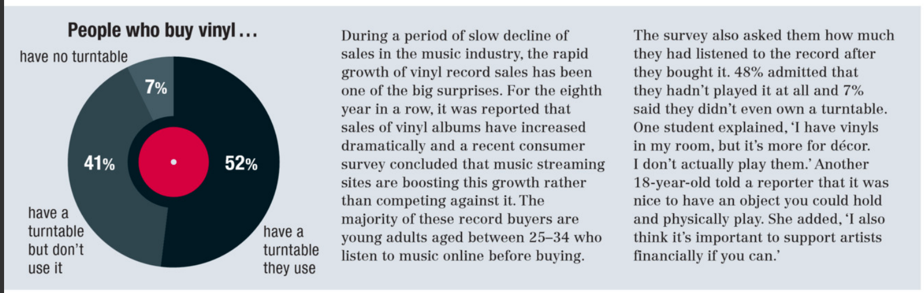
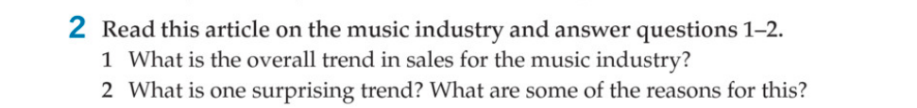

Answers
1) a slow decline
2) the rapid growth in viny record sales: music streamina sites are boosting sales, vinyls for decor, nice to have an object you can hold and physically play, and supporting the artists

Slide 16

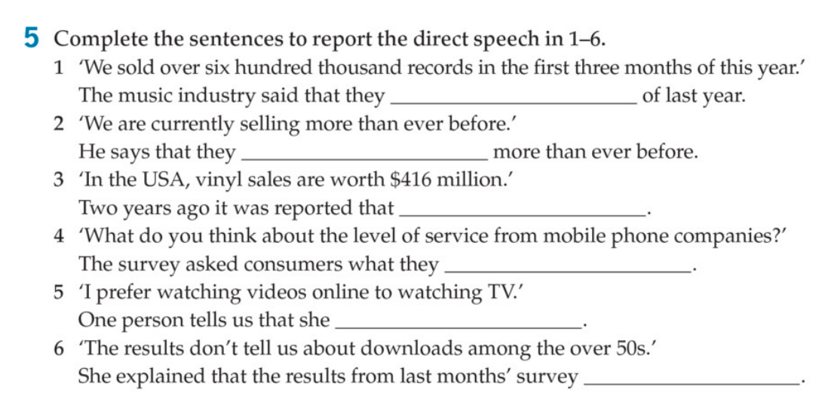

had sold over six hundred thousand records in the first three months
are currently selling
in the USA. vin sales were worth $416 million
thought about the level of service from mobile phone companies
prefers watching videos online to watching TV
didn't/don't tell them about downloads among the over 50s

Slide 17
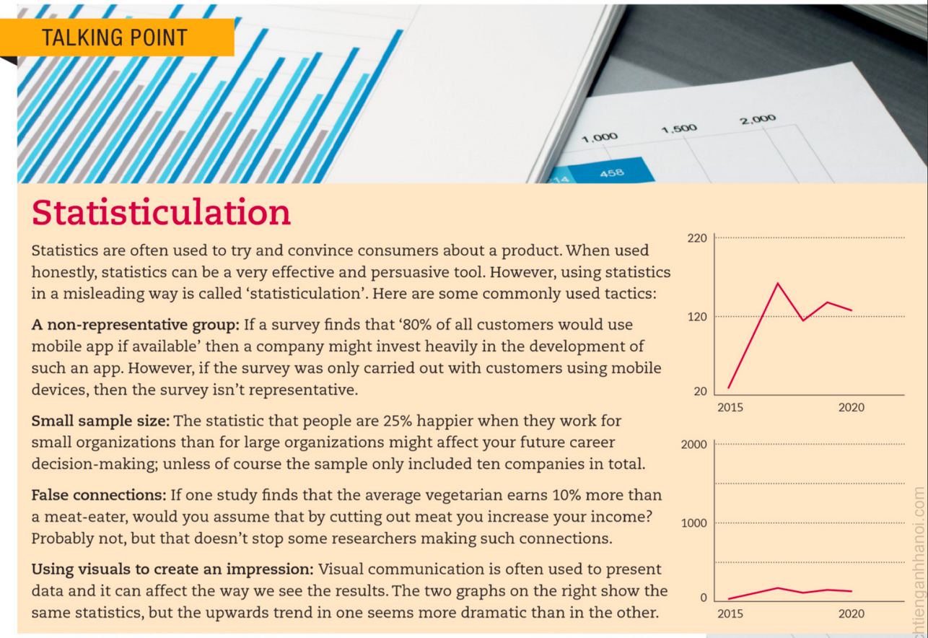
New phrases
A non-representative group: Nhóm không mang tính đại diện
Small sample size: Mô hình nhỏ
False connections: Kết nối sai
Using visual to create an impression: Sử dụng hình ảnh để tạo ấn tượng

Slide 18

3. Activities & Dicussion
Who collected the data?
What is the margin of error?
To avoid being misled by statisticulation, what kinds of questions should you ask about any statistics before you use them?
What statistical methods were used to analyze the data?
Who is presenting the statistic?
Are there alternative ways to analyze the data that might lead to different conclusions?
What is the context of the statistic?

Slide 19




















4. What were the summary and the conclusions?
Dealing in data
Describing trends
Discussing data
Reporting

Slide 20






References
Source: @canvacreativestudio
?Link to access:
https://www.canva.com/design/DAGF0sVU9nA/a-eKrywyoMuQEnaxxaHoXg/edit

Slide 21




Q&A
In the current era, network data is gradually becoming popular, so how to use it safely?

Slide 22








T
A
k
N
h
y
u
o

